Slide 1

Mitron Bank Data Analysis

Slide 2
Demographic Classification
For demographic classification I have conducted a thorough customer demographic analysis using Tableau and hear are key finding presented in visually engaging manner
Total customers : the dataset contains 4000 customers in dataset
Gender Distribution : I observe distinct gender distribution
Total Male customer:2597(64.9% of total customer)
Total Female Customer :1403(35.1% of total Customer)
Customer by Age Group:
Age group 25-35 emerges as the dominant segment with 1498 customer, in which 966 males and 532 females
Age group 35-45 has 1279 customers in which 834 males and 439 females
Age group 45+ age exhibits the smallest customer count standing at 538
Customer by City: Mumbai stands out with the highest customer count at 1078. dealing with 693 male and 385 females
Other cities follow suit:
Chennai:834
Bangalore : 751
Delhi NCR :744
Hyderabad :593
Customer by Occupation:
Salaried IT Employees emerge as the dominant category with 1294 Customer, in which 721 Male and 573 female
Other categories include Salaried other Employees (893),Freelancers(784),Business Owners(630) and Government Employees(399)
Customers by marital status:
Married customers dominate the landscape .constituting a substantial 78.41% of the total customer base (3136 Customers)
Unmarried Customers account for 21.6% totalling 864 individuals

Slide 3
Spending Insights & Income Utilization
For Spending insights and income utilization I have conducted a thorough customer Spending analysis using Tableau and hear are key finding presented in visually engaging manner
key Metrices: :
Total Income :1240M
Total Spending:531M
Average Income Utilization:42.82%
Income ,spend, utilization by Age Group:
Age group 25-34 exhibits the highest income ,spend and utilization(43.66%)
Second-highest is the 35-45 age group with a utilization rate of 46.52%
Total Spends by Category:
Highest spending in bill category(105M)
Other significant categories: Grocery(86M), electronics(80M).and least in Other category(16M)
Income, Spend ,utilization by Occupation :
Salaried IT Employee lead in income($477M), spend($244M) and utilization (51.04%)
Business Owners show an income of $265M,spend of $88M,and a utilization rate of 33.22%
Government Employees have the lowest utilization at 29%
Income, Spend ,Income Utilization by city:
Mumbai outshines with the highest income and spend , resulting in a utilization rate of 51.43%
Total spend by Payment Type:
Credit Cards dominate spending , accounting for $216M with a utilization rate of 17.45%
Total Spend by Gender:
Males lead in Spending with $357M while females contribute $154M
Spend by Marital Status:
Married individuals top the spending charts with $429M,surpassing unmarried individual at $102M
Total spend by Month:
September emerges as the highest spending month, accounting for $116M,constituting 21.84% of the total spend
Income Utilization by Gender:
Male exhibit a higher income utilization rate at 44.39%, compared to females at 39.92%
Income Utilization by Marital Status :
Singles show a utilization rate of 43.06%,slightly surpassing married individual at 42.77%

Slide 4
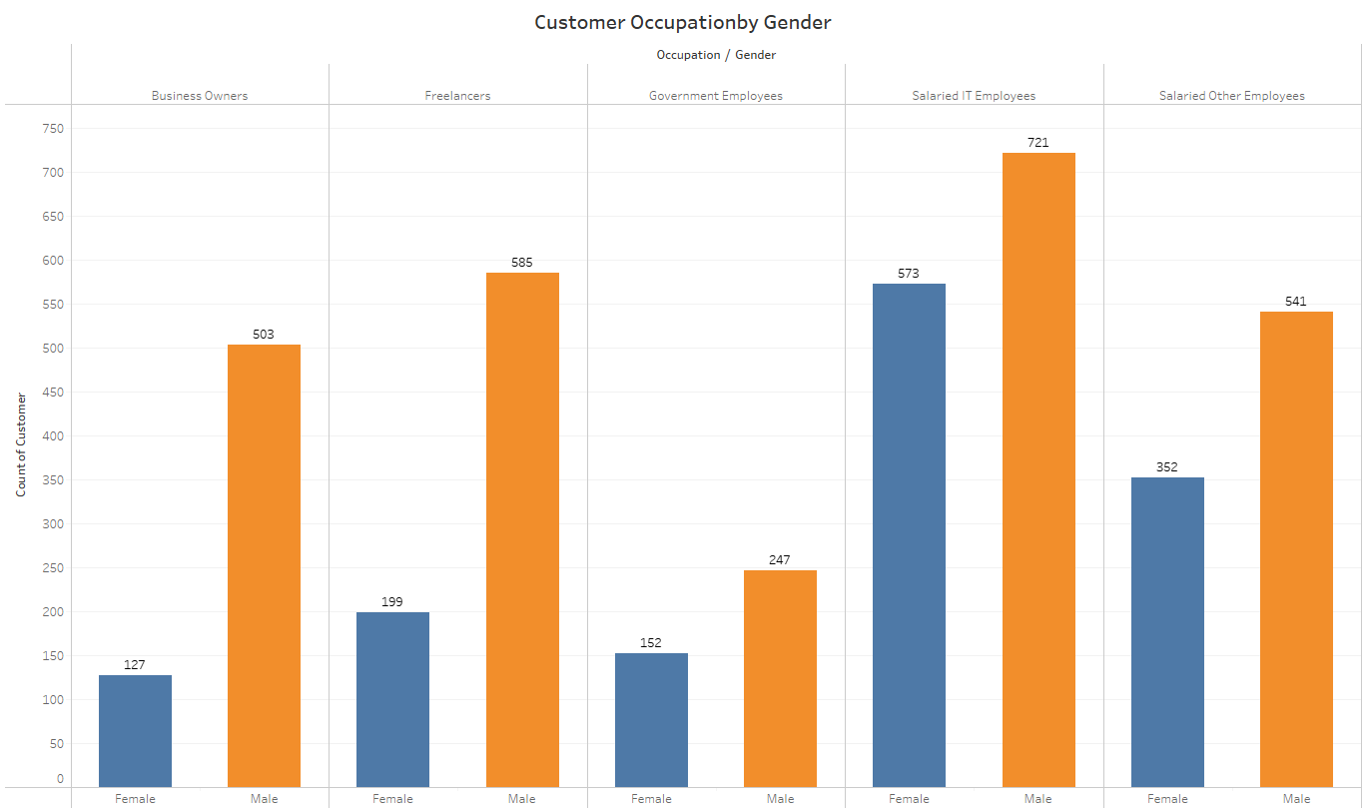
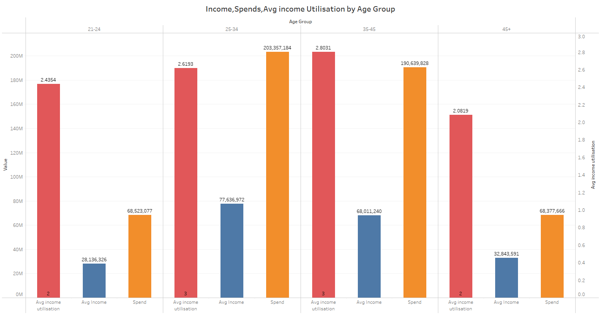
Key Customer Segments
The in-depth analysis encompassing demographics, spending behaviors, and financial preferences has unraveled key customer segments poised to become high-value users of the new credit cards. This profiling delves into nuanced insights, providing a strategic lens for tailored offerings
1. Demographic Profiling:
Age Group Dynamics:
The age group 25-34 and 35-45 emerges as a significant segment, demonstrating higher income, substantial spending, and a utilization rate of 43.66% and 46.72%
This age bracket showcases a balance between income, spending habits, and a keen inclination towards credit card utilization.
Occupation Influence:
Salaried IT employees, Salaried Other Employee, Freelancers constituting a substantial portion, are potential high-value users, given their elevated income, considerable spending, and a utilization rate of 51.04%, 42.10%, 45.80%.

Slide 5
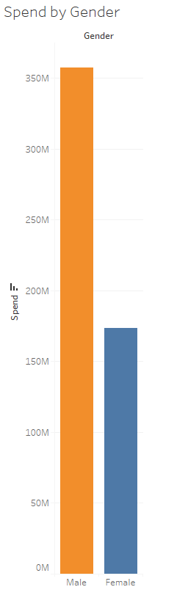
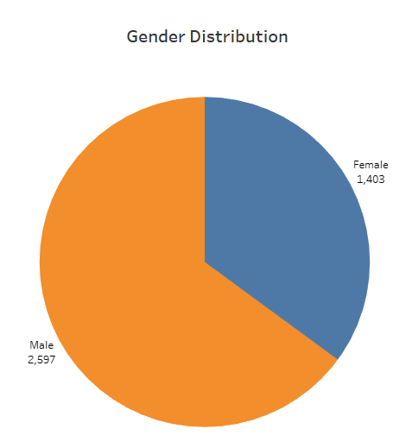
Key Customer Segments
The in-depth analysis encompassing demographics, spending behaviors, and financial preferences has unraveled key customer segments poised to become high-value users of the new credit cards. This profiling delves into nuanced insights, providing a strategic lens for tailored offerings
2. Gender-Based Considerations :
Male Gender Dynamics:
The gender-based analysis accentuates that males, on average, earn and spend more than females, displaying a higher utilization rate.
This implies that males, with their elevated financial activity and utilization tendencies, constitute a targeted customer segment for the new credit card offerings

Slide 6
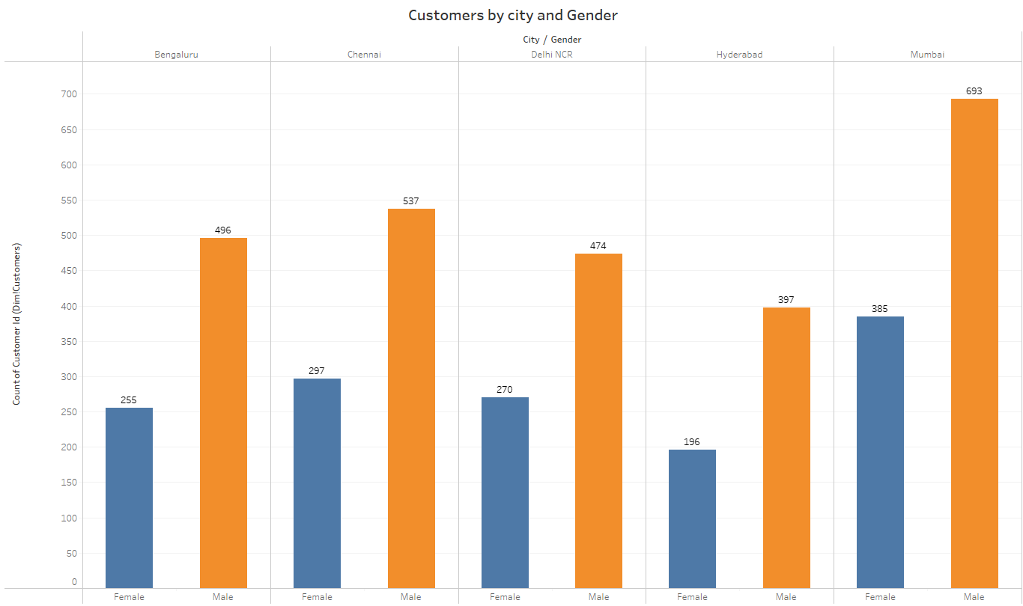
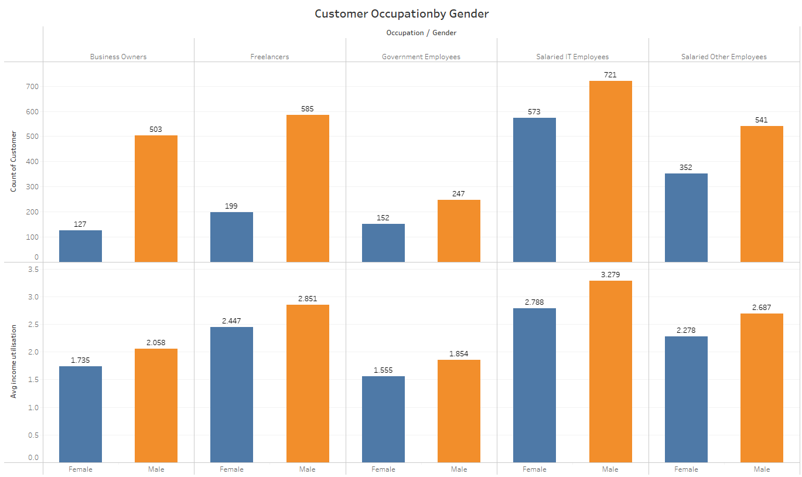
Key Customer Segments
The in-depth analysis encompassing demographics, spending behaviors, and financial preferences has unraveled key customer segments poised to become high-value users of the new credit cards. This profiling delves into nuanced insights, providing a strategic lens for tailored offerings
3. City-wise Considerations:
Regional Dynamics :
City-wise variations indicate that customers in cities like Mumbai, Delhi NCR, Bengaluru exhibiting higher income and spending with a utilization rate of 51.43%, 48.03% and 43.46% could be a prime target for credit card offerings.
Tailoring features to align with the spending patterns of customers in specific cities is imperative for capturing high-value users..

